Slide 1
Capstone Project – Final
Presentation
Best location in Calgary for a new Restaurant
Adeniyi Bello

Slide 2
Introduction
Successful restaurant chain in the Eastern Region of Canada seeks to expand to Calgary.
Restaurant owner wants to avoid competition while having significant attractions around
Seeks to use data analytics to decide best location in Calgary

Slide 3
Data
Data obtained from public data on Wikipedia and Foursquare API
Additional analysis was performed by my client to provide a weighted rank of how much competition or attract a venue type is on a scale of 1-10.

Slide 4
Methodology
Obtained all venues in all neighbourhood in Calgary using the Foursquare API
Assign Category weights (Attraction and Competition ranks) to each venue
Use KMeans to compute clusters and the cluster with the highest average weight is the best location for our restaurant.

Slide 5
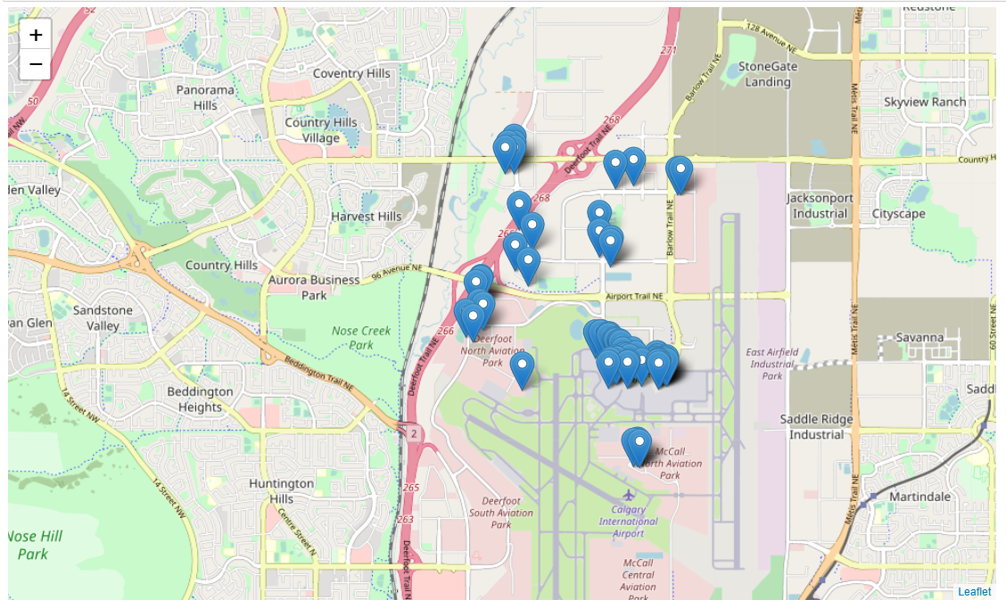
Recommendation
Our analysis showed that the airport area is the best location for the restaurant

